Slide 1
MyFGIS Customer Guide
Getting Started:
Establish an Identity Verified User account
Log into MyFGIS
I already have a FGIS Customer (CIM) / MyFGIS number
I need a new FGIS Customer MyFGIS number.
I was given a MyFGIS # to request access.
Features:
MyFGIS Panel
View Billing
View Certificates in FGISonline CRT
View Service Results in FGISonline IDW
Service Request
Update Preferences
Manage Contacts
Connect Contact to System User
Access Management
Associations vs. Roles
Review Access Requests
Managing Roles: Assign / Expiring / Terminate
Request Access for Staff

Slide 2
Getting Started: Existing
All information migrated from FGISonline Customer Information (CIM).
Primary point of contact was set as the manager and will have access.
If you do not have access, Request Access.
If you do not know whom the primary POC is for your CIM/MyFGIS#, email MyFGIS@usda.gov with your name, the organization you represent, and the existing CIM/MyFGIS#
A MyFGIS administrator will review your email and respond. If the primary POC does not exist, they will be able to grant you access.
Explore your next steps here

Slide 3
Getting Started: New
Step 1: Register with FGIS as an Individual or Business.
Step 2: You have a new MyFGIS number!
Review next steps

Slide 4
Log into MyFGIS
Navigate to MyFGIS: https://fgisonline.ams.usda.gov/MyFGIS
Log in with your Identity Verified account.
If your account is not verified, you will not be able to access FGISonline applications.
If you do not have a user account, follow the prompts from the login page to establish a Login.gov account. This user account must be Identity Verified.

Slide 5
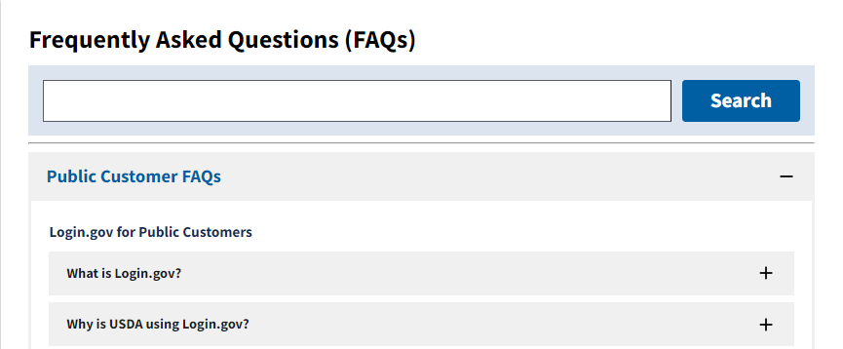
Create an Identity Verified User Account
Identity Verified account FAQ: Frequently Asked Questions (FAQ)
You must use an email address assigned to you. A shared email account cannot be used.

Slide 6
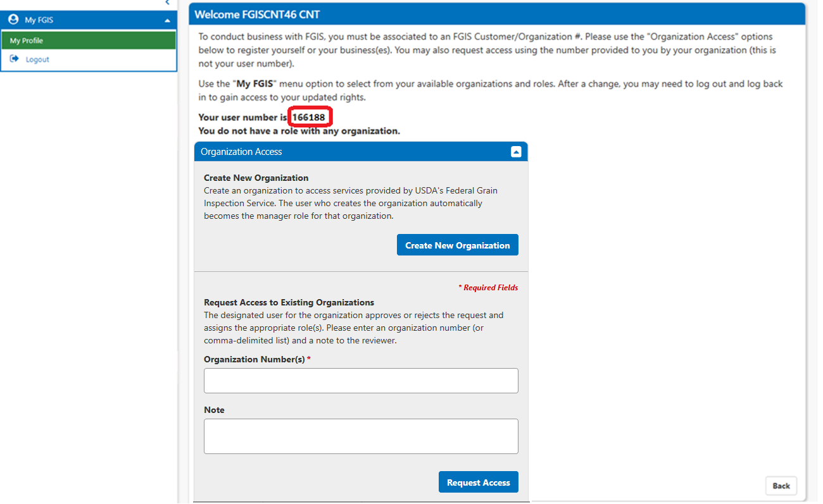
Log in / Register
You are logged in, but not linked to a MyFGIS#.
Your User Number is displayed.
This is not a MyFGIS#
Return to profile from the My FGIS menu panel
You must have a role with a MyFGIS# to conduct business with FGIS.
Continue by either:
1. Requesting access to a MyFGIS# provided to you by your organization
2. Register for a new MyFGIS# for your organization or yourself.

Slide 7
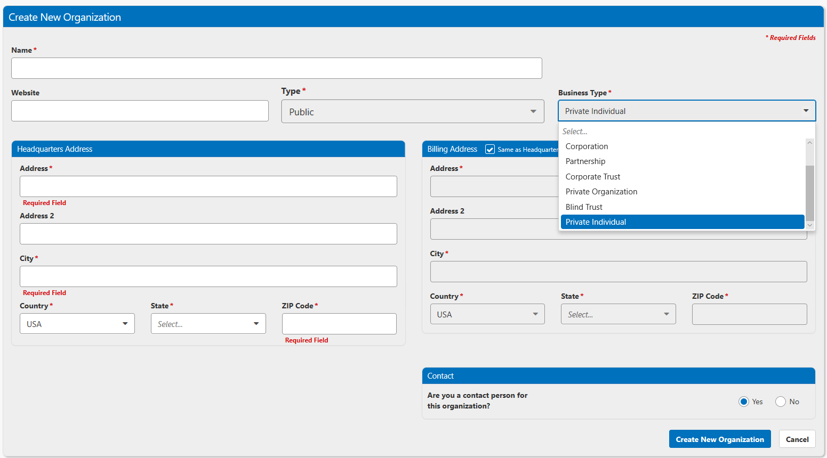
Step 1: Register with FGIS
Provide details about yourself or the company you are registering.
Name should be recorded as the legal business name, if you are registering an organization
Identify as an individual or select your business type.
Registering for more than one MyFGIS# will allow you to manage your relationship with FGIS in a more granular way, whether by elevator, office, region, or other means. Each registered organization allows the independent management of locations, people, and roles. Organizations may share the same USDA financial account number.
Leave the ‘contact’ question as Yes to have system access for the organization.
Select ‘Create’ to get your new MyFGIS#

Slide 8
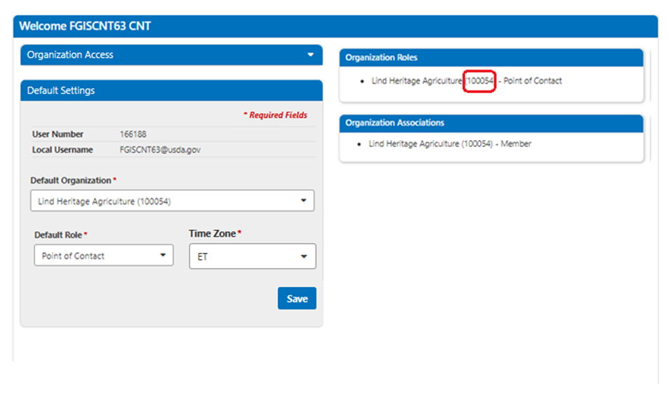
Step 2: You have a new MyFGIS number!
A new MyFGIS number has been issued and will always be shown next to your chosen name.
Your profile identifies that you are listed as a Member of this new Organization, and hold the role of ‘Organization Manager’
The ‘Organization Access’ panel is now minimized. You may request additional access or register for additional MyFGIS numbers, if necessary, by expanding the panel.
Use the ‘Default Settings’ panel to update your primary organization and role

Slide 9
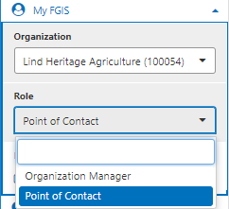
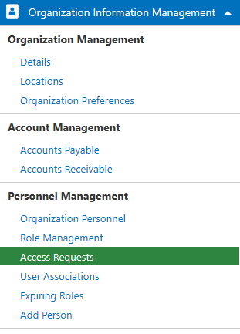
Step 2b: You have a new MyFGIS number!
The MyFGIS Menu panel offers ability to change your active organization and role
As the organization manager, you control further role management.
Your menu will refresh and display the options available to the Organization and Role

Slide 10
What’s next?
Review/Update financial accounts to enable billing document features.
Provide your MyFGIS # to an official service provider and request they attach it to certificates to track in the Inspection Data Warehouse (IDW).
Official Service Providers using the FGIS Certificate (CRT) program, you may preview certificates and download your official documents.
You may proceed with your annual Export Registration, or apply for a Designation by selecting ‘Delegations, Designations and Export Registrations.’
Find links to these modules at https://fgisonline.ams.usda.gov/

Slide 11
USDA Account Overview
When your MyFGIS# was assigned, it was issued a COD account for requesting service. Using the COD account requires payment in advance of services.
Use of a USDA charge account (FMMI) results in monthly billing statements. The charge account must be linked to your MyFGIS#.
If you do not have or want to use a USDA charge account, please skip to Step 5.

Slide 12
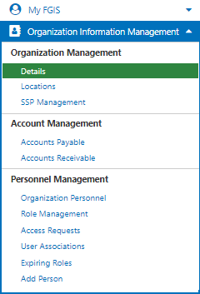
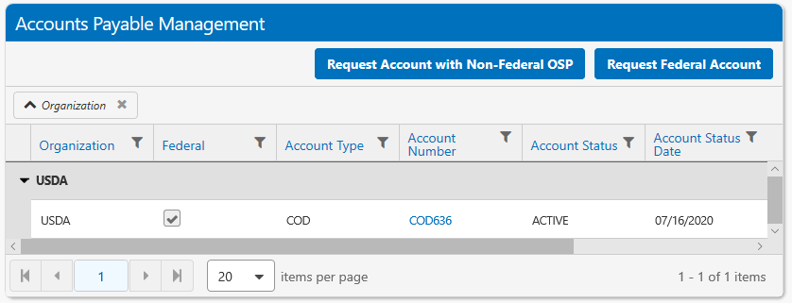
Step 3: Review USDA Accounts
Please navigate to Accounts Payable to view your accounts.
To Link or Create a new Charge Account, Please select ‘Request Federal Account.’

Slide 13
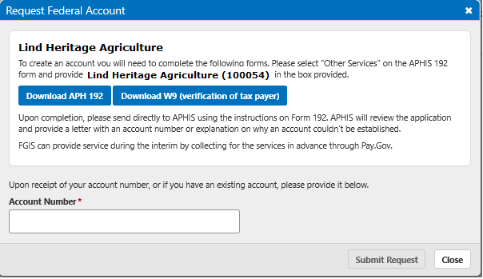
Step 4a: Request/Link your USDA Charge Account
If you do not have a USDA Charge account and wish to have one, please follow the instructions to complete this external process.
Once you have the account number, return to this step.
Provide your Account Number and click ‘Submit Request’.

Slide 14
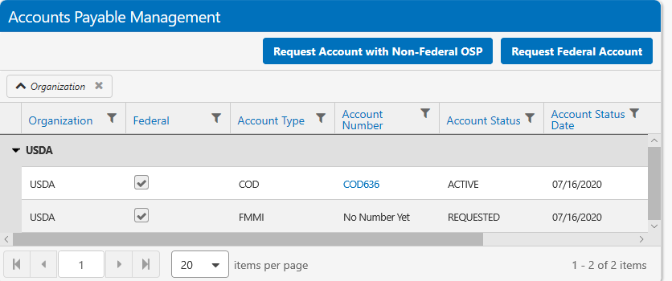
Step 4b: Request/Link your USDA Charge Account
The pending request will display on your ‘Accounts Payable’ grid.
A USDA staff member will review the request and update the status.
Only accounts in ‘Active’ status may be used for requesting services.

Slide 15
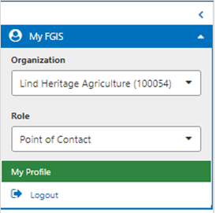
Step 5: Update Default Settings
The MyFGIS Menu panel is where you access your profile
Your default MyFGIS# and role were set on your profile page after you registered
Updating your defaults will change the organization/role that are initially active after every login.
Your User Number is displayed here.
This is not a MyFGIS#
Select the default organization MyFGIS# to be used at login

Slide 16
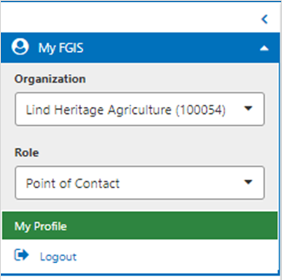
The MyFGIS Panel
Use the MyFGIS menu panel to:
Change your organization and/or role in the system
Access your profile
Logout

Slide 17
Common Grid Features
Drag a column title to the header to group
Click Filter icon to search within that column
Change page number and page size
Click column title to toggle sort on/off, sorting by multiple columns indicated by a number
Many grids also offer an excel or pdf output

Slide 18
Add Users to Your MyFGIS Account
Before a user can be added to your field office, they must have an Identity Verified user account.
Next, the user must request access to your MyFGIS Account.
After a request for access to a MyFGIS# has been made, the Organization Manager or Role Admin must grant that request.

Slide 19
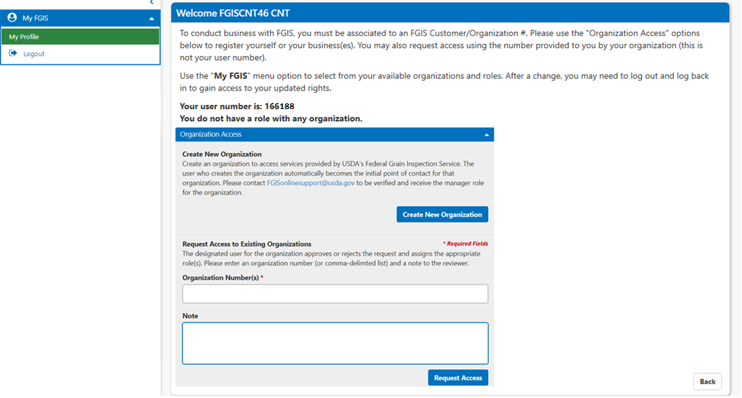
Requesting access to a MyFGIS#
Log Into MyFGIS from FGISonline
Please list the MyFGIS#(s)
Request access.
Assigned roles are not available until the next login.
MyFGIS#
Track requests on the request list.

Slide 20
Association vs Roles
A user must first be ‘Associated’ to the office.
Once associated, they may be granted a role.
An active role is required to use the system.
A single role is selected for specific actions.
The roles available to your organization are determined by your organization type/subtype combination.

Slide 21
Roles
Organization Manager
Maintains all organization information such as locations, accounts, users and their roles, etc.
Create / Review Service Requests.
Organization Role Admin
Manages user and personnel information, user roles, and user access to organizations.
Service Requester
Create / Review / Submit service requests
Service Request Preparer
Create and Review service requests only.

Slide 22
Roles continued
Organization Acct Payable
Request link to Accounts
View Account Status History
View all billing documents for accounts linked to the organization.
A/P Bill Viewer
View all billing documents for accounts linked to the organization.
View Certificate Customer
Access FGISonline CRT to preview/view official certificates.
IDW Customer View
Access FGISonline IDW to review Inspection records

Slide 23
Roles / Permissions
Role | Manage Roles | Manage Locations | Manage Preferences | Create SR | Submit SR | View SR | Review Accounts | View Bills | View Certs | View Data
Org Manager | X | X | X | X | X | X | X | X
Role Admin | X
Org Acct Payable |  |  |  |  |  | X | X | X
A/P Bill Viewer |  |  |  |  |  | X |  | X
Svc Requester |  |  |  | X | X | X
Svc Req Preparer |  |  |  | X |  | X
View Cert Customer |  |  |  |  |  |  |  |  | X
IDW Customer View |  |  |  |  |  |  |  |  |  | X

Slide 24
Review Access Requests
The Organization Manager or Organization Role Admin will:
Step 1: Login as Manager or Role Admin to view requests
The default screen is the ‘Access Requests’ screen.
The Access Requests screen is also available under the Organization Management heading on the left menu.
Step 2: Approve or deny access.
Approved Users are now ‘Associated’ and may be assigned roles.

Slide 25
Step 1: Navigate to Access Requests
Default page for the organization manager and organization role manager roles

Slide 26
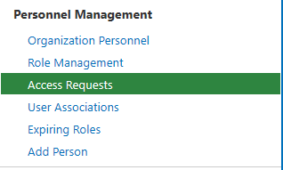
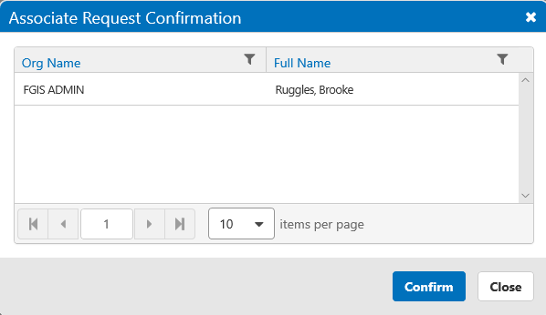
Step 2a: Grant request
4.
1.
2.
3.
All requests are available on the ‘Access Requests’ page.
The screen is pre-filtered to the ‘Requested’ Status.
Any message from the user is in Notes
Grant Access by selecting the checkbox next to the user(s) you wish to grant access.
Use the ‘Assign Selected’ button.
Use the ‘Confirm’ button to grant the request.
5.

Slide 27
Step 2b: Deny request
All requests are available on the ‘Access Requests’ page.
The screen is pre-filtered to the ‘Requested’ Status.
Deny request by hitting the ‘Reject’ button.

Slide 28
Managing Roles
As the Organization Manager or Organization Role Admin :
Assign new roles
Extend expiring roles
Terminate roles
Send access requests for staff

Slide 29
Assigning Roles to Users
As the Organization Manager or Organization Role Admin :
Step 1: On the left menu bar, select Role Management
Step 2: Search for the people to assign a specific role.
Step 3: Identify the role to assign, timeframe, and select ‘Grant Roles’
For Stowage Exam Service Requests, choose Assigner
The dates are pre-set to the maximum time of 90 days.
Staff may hold more than one role.
Step 4: Confirm Role selection
The ‘Expiring roles’ link on the menu provides a quick way to view roles expiring soon and extend them to the maximum of ninety days.

Slide 30
Step 1: Navigate to Role Management

Slide 31
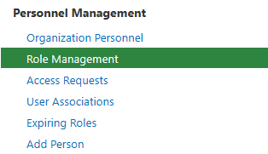
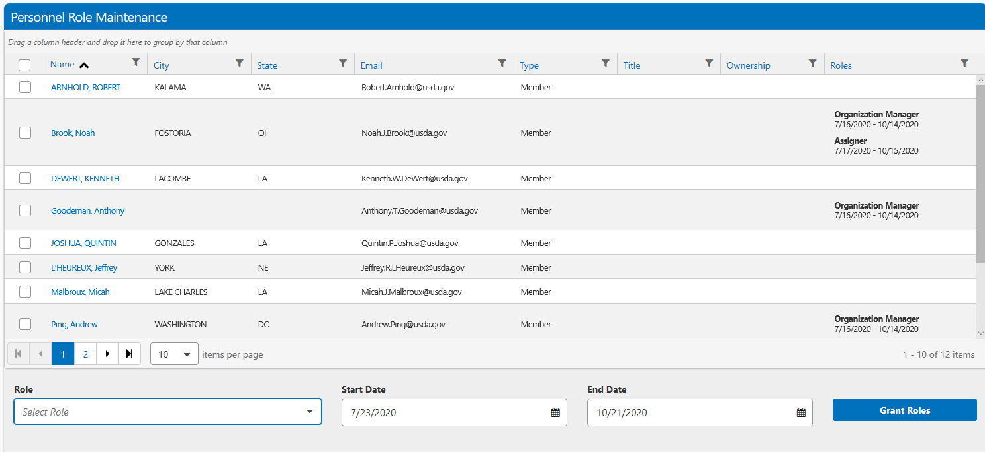
Step 2: Search for users
1. Use the paging or column filters to find and select one or more users
2. The active role(s) of the user appear on the far right with the timeframe
3. Field Office management of other offices will show in your list to enable them to place detail requests with you for their staff.
1.
2.
3.

Slide 32
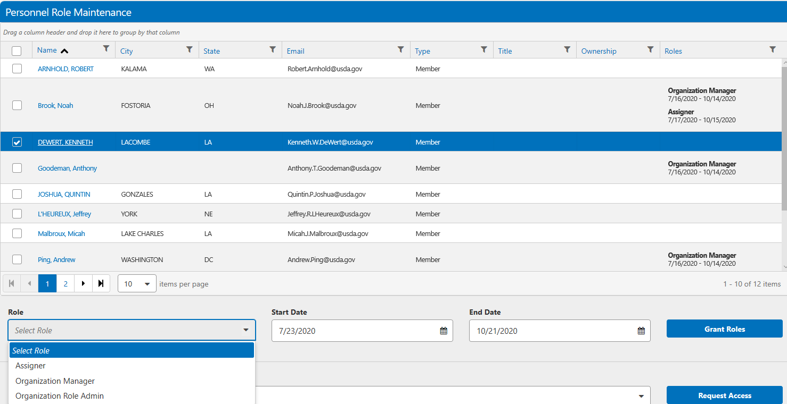
Step 3: Select the role to assign
1.
The selected users are highlighted.
Select a role
For Stowage Exam Service Requests, choose Assigner
The dates are pre-set to the maximum time of 90 days.
Choose ‘Grant Roles’
Staff may hold more than one role.
3.
2.

Slide 33
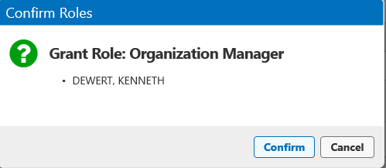
Step 4: Confirm selections
Confirm the role and person to assign the role.
The role(s) will be updated in the listing.

Slide 34
Managing Expiring Roles
Roles expire every 90 days
ACTION: You will need to Re-authorize each role every 90 days.
Please review the ‘Expiring Roles’ screen weekly to avoid any access disruption for your staff
Roles may easily be extended to the full 90 days.

Slide 35
Manage Expiring Roles
Roles assignments are only effective for 90 days to comply with security requirements.
Select the button ‘Extend 90 days’ to set the role expiration date forward the full 90 days.

Slide 36
Terminate a role
As the Organization Manager or Organization Role Admin :
Step 1: On the left menu bar, select Role Management
Step 2: Identify and select the person whose role will be terminated.
Step 3: Set the expiration date.
Step 4: Role will terminate on expiration date.
Roles may be added later by following the ‘Assign role’ process

Slide 37
Step 1: Navigate to Role Management.

Slide 38
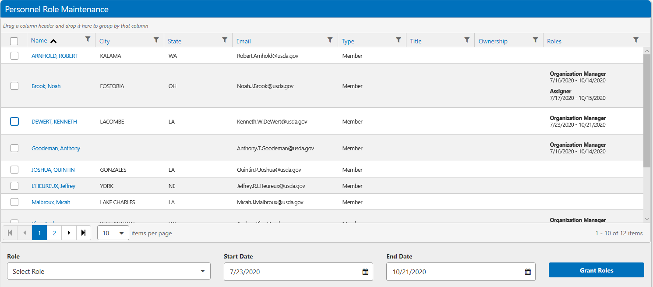
Step 2: Select desired user to terminate
Open the user’s role panel by clicking the user’s name.

Slide 39
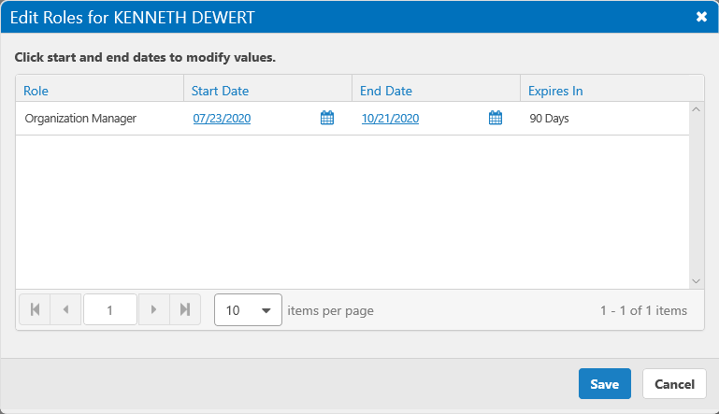
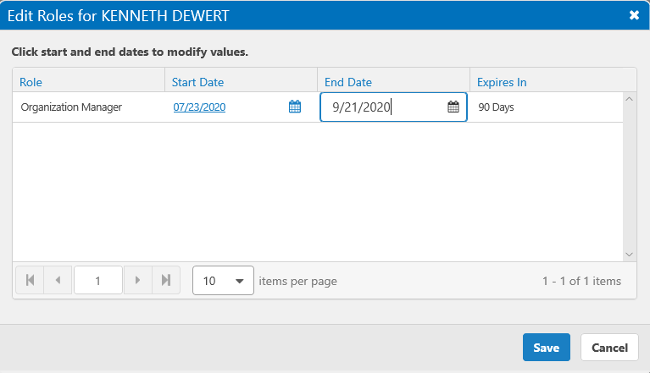
Step 3: Identify role to change End Date
1.
Select the Calendar
Change the End Date.
View the update
Save.
2.
3.
4.

Slide 40
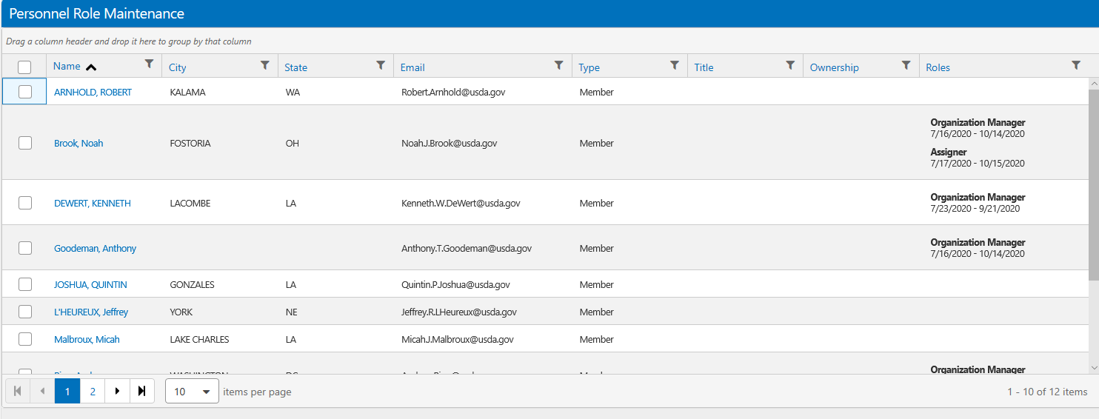
Step 4: Termination Date is set

Slide 41
Send a Request for Staff
As Org Manager / Role Manager, you can send access requests for any of your users to be associated with another office (e.g., setting up additional MyFGIS numbers).
You can only select from those organizations you are associated with as a user, which can be found on your own profile screen.

Slide 42
Place access requests for your users
You can only select from those organizations you are associated with as a user, which can be found on your own profile screen. This is other organizations, not your current one.

Slide 43
View Billing
Must have Org Manager, Accounts Payable, or A/P View Bill role
Search for Billing Documents
View service estimates and bills with payment posting information for Cash-on Delivery (COD) Accounts.
For USDA charge “FMMI” Accounts, multiple documents are collected monthly onto the account statement
Search by Billing Lines
Sort / Filter to compare with account statements
View Billing Document
Current version, previous versions, and all changes are noted.

Slide 44
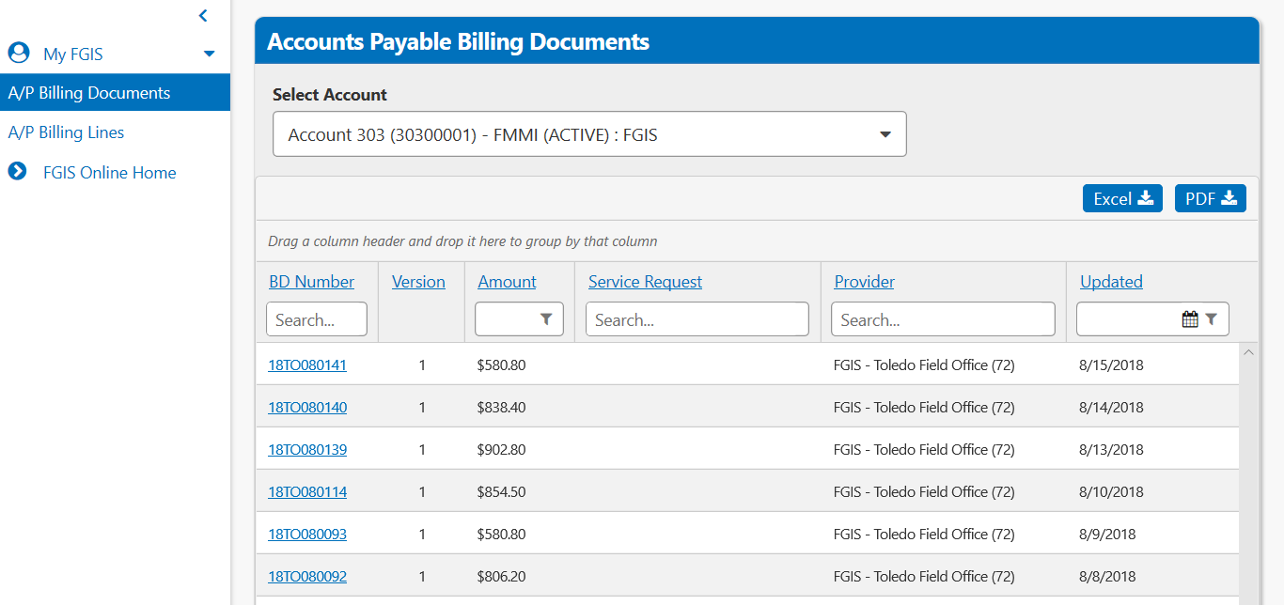
A/P Billing Documents View
Toggle across your various accounts (e.g. FMMI, COD)

Slide 45
A/P Billing Lines View
This view allows you to emulate your account statement by looking at line items across multiple billing documents
Toggle across your various accounts (e.g. FMMI, COD)

Slide 46
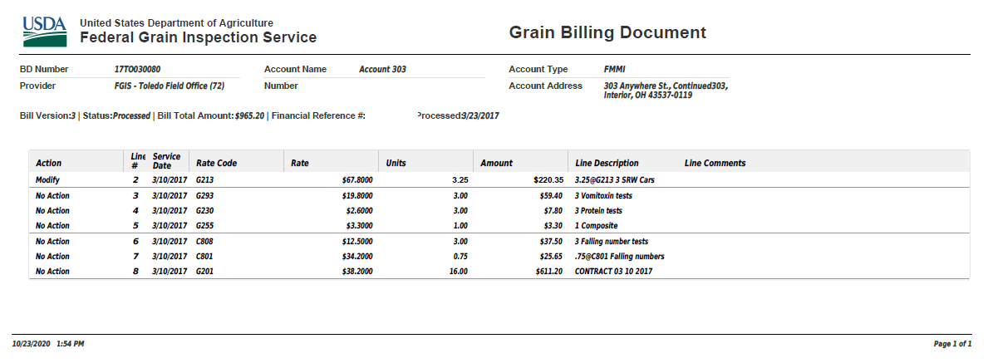
Bill Details PDF Format

Slide 47
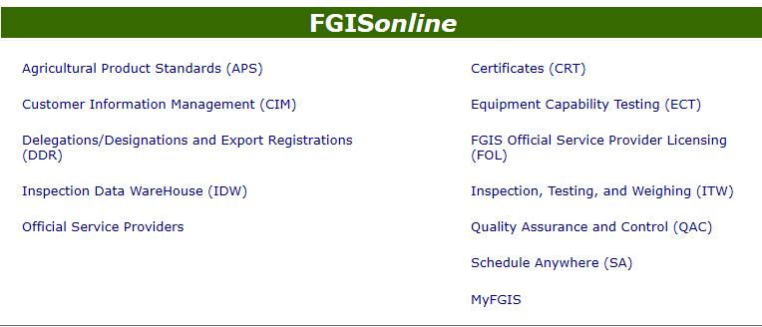
View Certificates
Must have ‘View Certificate Customer’ role
Open FGISonline Certificates at https://fgisonline.ams.usda.gov/
View/Download official certificates
Preview ‘In-Process’ documents

Slide 48
View Service results
Must have ‘IDW Customer View’ role
Open FGISonline Inspection Data Warehouse (IDW) at https://fgisonline.ams.usda.gov/
View/Download service results from all official service providers recording your MyFGIS number.
Validate any Certificate

Slide 49
Service Request

Slide 50
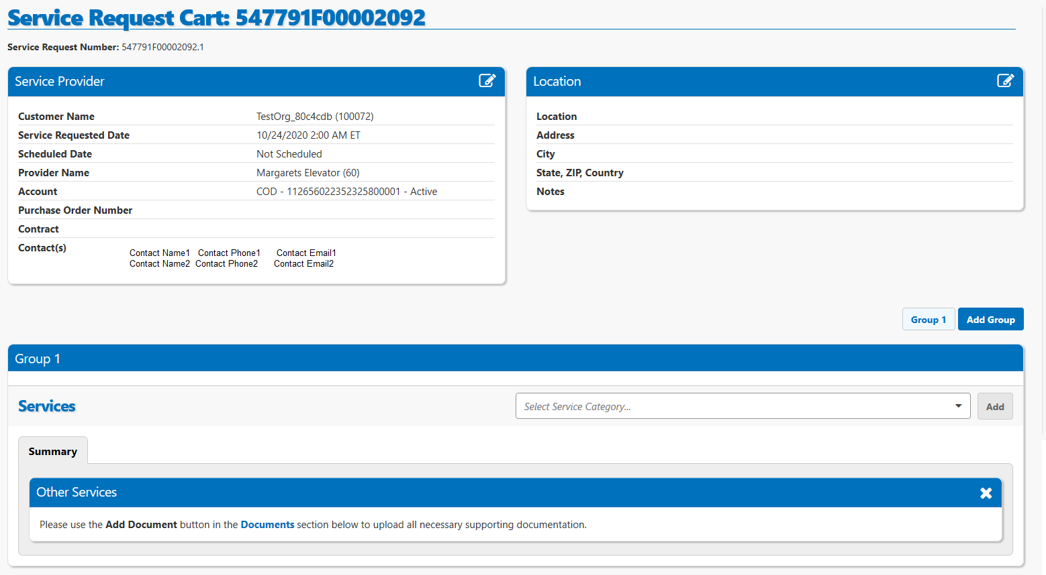
Cart

Slide 51
Cart continued

Slide 52
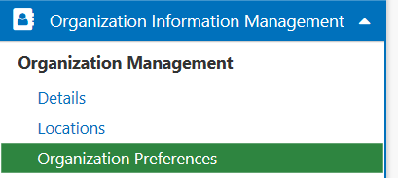
Choose Preferences
Three possible preferences
Record Release (Inspection Data Warehouse)
Email or Web Service
Emails are sent to users with type of “IDW Records POC”
Web service available for download inside IDW website.
Record Release Format (CSV or XML) (Inspection Data Warehouse)
Service Request Account Provider (Yes /No)
Only for Official Service Providers (OSP), allows the OSP to ‘opt-in’ to offering accounts and service request through MyFGIS.

Slide 53
Contacts vs Users
Contacts are added to the user pool, but cannot be assigned system roles
Contacts, may be defined with ‘Person Types,’ so that your organization can be fully described according to the law and regulations.
Person Types support both Titles and specific system functions.
Person Types are NOT system security roles.
The system may send emails to contacts
A contact with an active ‘type’ of ‘IDW Records POC’ will receive emails according to the organization preferences.
A contact attached to the service request will be emailed updates about the request.

Slide 54
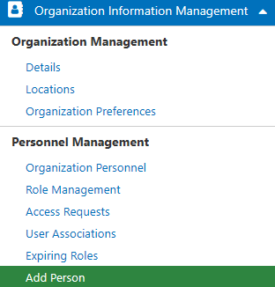
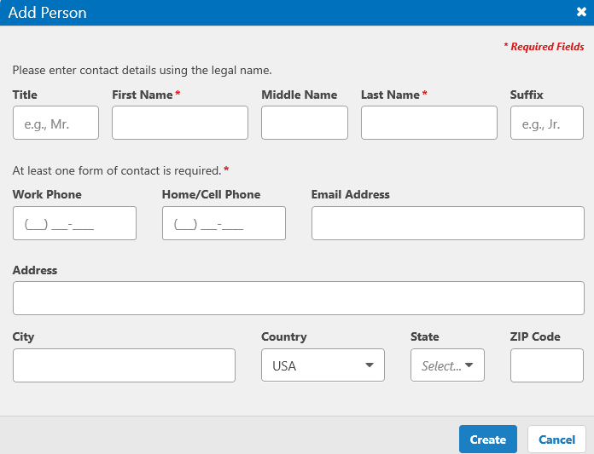
Add a contact
Select ‘Add New’ from the Personnel Management area

Slide 55
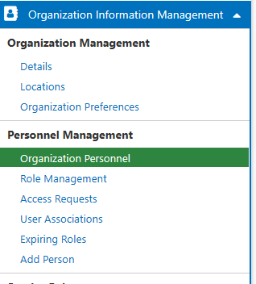
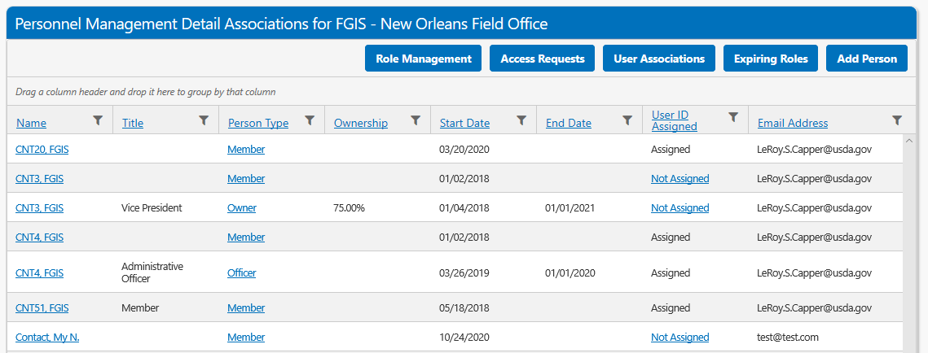
Contact/Person/User & Types List
‘Organization Personnel’ displays all contacts and types.
Select the ‘Person Type’ column value for a contact to update them.
If a UserID is ‘Not Assigned’, follow that link to connect the contact to an existing system user.

Slide 56
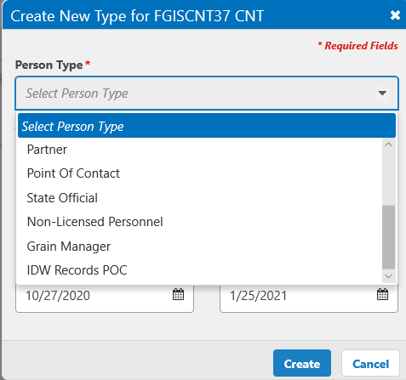
Update Contact/Person Types
Person Types come from many sources, including your annual export registration.
Select ‘Create Person Type’ to add a type.
Any contact with the person type of ‘IDW Records POC’ will get the IDW release emails twice a day.

Slide 57
Convert contact to system user
Once your contact signs up as a user, or if they are already a user, you will have a duplicate entry.
Use their existing User Number (found on ‘My Profile’) after login, to connect them and grant them system roles.

Slide 58
Questions / Feedback?
MyFGIS@usda.gov

